Slide 1
Bus Equipment Recommendations

Slide 2
Available equipment options for installation on school bus should be considered carefully and meet applicable construction standards developed by Ohio State Highway Patrol and Federal Motor Vehicle Safety Standards.

Slide 3
We have reviewed numerous suggestions and believe these recommendations are practical, cost effective and can be implemented in a reasonable time frame.

Slide 4
PPE - Bus drivers may wear facemask or face shields, the face shields should not have any distortion.
Hand Sanitizers - Each bus may be equipped with a sanitizer dispenser available for use and mounted as described in OHP Inspection Manual dated June 15, 2020 attachment #1 (non-alcohol?)

Slide 5
To the extent possible and based on weather conditions windows and vents should be open and used to increase ventilation

Slide 6
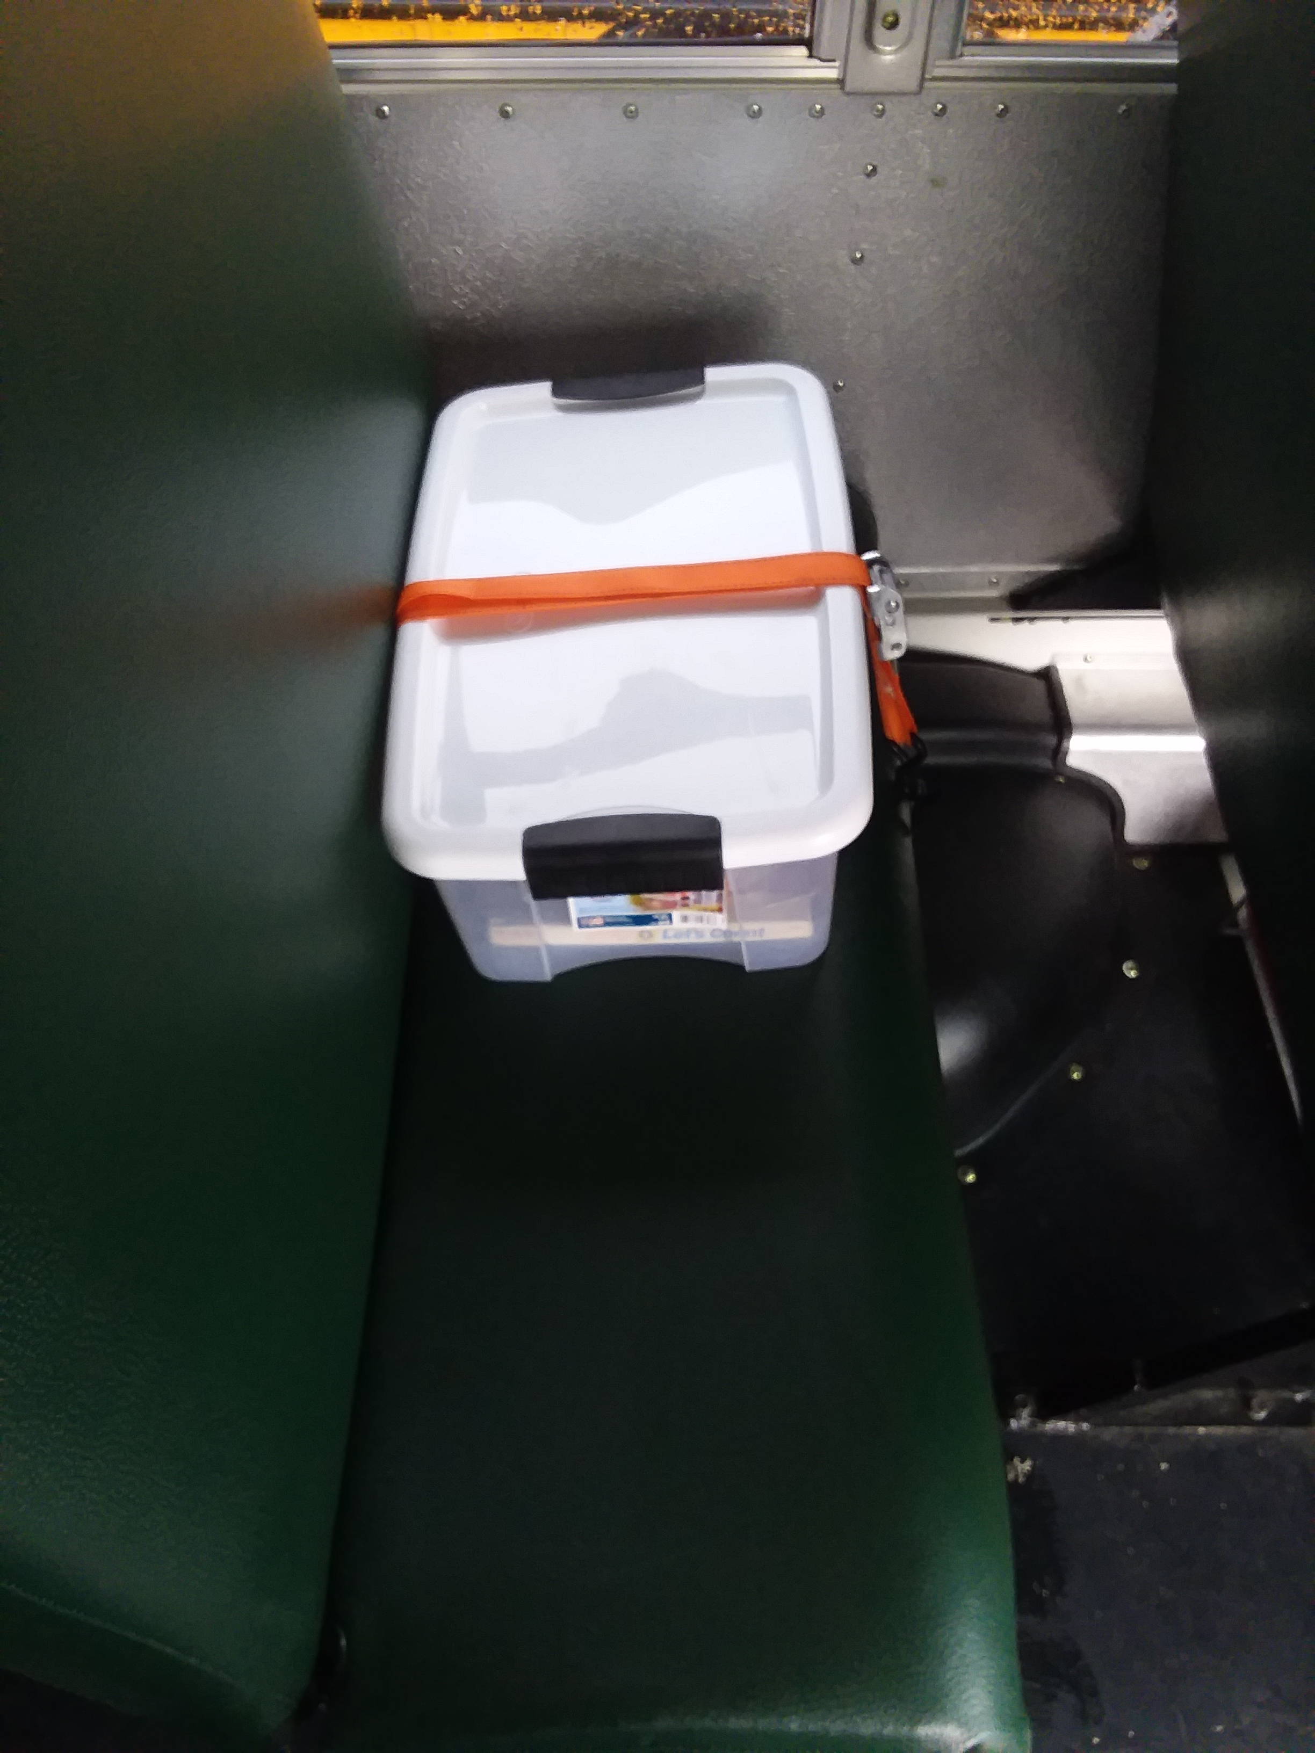
Cleaning supplies used for cleaning the bus may be kept on the bus when driver is present but shall be mounted securely. Locations could include the following:
Storage area above the driver
In a storage box secured by straps in the first seat behind driver
In outside storage compartments

Slide 7
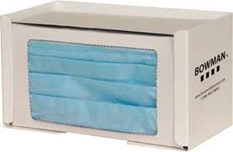
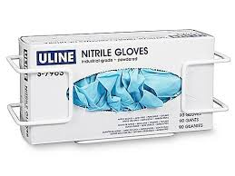
Cleaning supplies should be removed at completion of route.
Facemask and glove dispensers may be mounted for student usage and should be mounted similar to sanitizer dispensers.

Slide 8
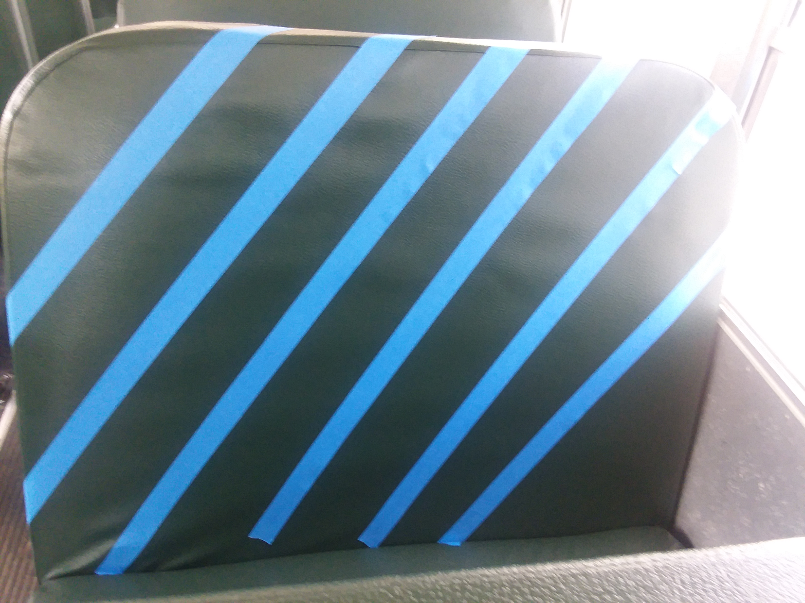
If seats are not to be used due to social distancing it is suggested that painters tape be used to indicate seat not to be used

Slide 9
Signage mounted for proper hygiene and cough etiquette.
Should be secured properly
Should not cover any safety information
Should not obstruct driver visibility

Slide 10
Additional equipment options
Driver protective Barriers
Have been listed as an approved option.
Details in attachment #2
The requirements to meet the installation requirements are rather extensive and time consuming
Kits are not readily available
May not be most practical option based on cost and installation time

Slide 11
Air purification systems/UV Light Systems
May be a long term solution
Technology is in developmental stages
Approved by OHP see language in attachment #3

Slide 12
Attachment #1 Hand Sanitizer Option
Hand Sanitizer: (Added 06/15/2020)
Personal use
Stored securely with in the driver’s compartment, 12oz or less in capacity.
Entry mounted dispenser
Must be securely installed in the driver/entry area, either behind the handrail or just to the right of the driver on the side of the dash.
Cannot cause a catch point to the passengers as they enter or exit, nor can the installation encroach into the bus entry point. Overall dimensions for the dispenser cannot exceed 6” in depth, 7” in width, and 12” in height.

Slide 13
Attachment #2 Driver Protective Barrier
Driver Protective Barrier: (Added 06/15/2020) o
The driver protective barrier panel shall be installed directly behind the driver and flush to the outside wall of the bus or at a dimension that will prohibit a passenger from coming in contact with the driver’s area. If installed, the passenger seat directly behind the driver must be rendered inoperative (this can be accomplished by removing the lower seat cushion) to comply with FMVSS 571.222. The panel shall be constructed of clear material compliant with FMVSS 571.302 such as polycarbonate. The end of the barrier panel exposed to the passenger compartment shall be secured to a padded stanchion extending from the floor to the ceiling. The stanchion shall be attached to the roof bow or a reinforced panel in the ceiling and a solid connection point on the floor. The barrier panel shall be in compliance with FMVSS 571.302 and FMVSS 571.222.
Note: With the lower seat cushion removed, all exposed seat frame must be wrapped in padding in compliance with FMVSS 571.302 ▪ A barrier cannot take the place of a manufactured installed seat as it will compromise the floor integrity.

Slide 14
Attachment #3 Air Purification
Air Purification: (Added 06/15/2020)
Air purifications systems may consist of HEPA and/or UV technology. Installation of the air handlers must meet or exceed all requirements for head impact area, emergency exits, nor may they decrease the inside body height as required. Units must be installed and maintained per the manufactures specifications. Control of fan speed and functionality of the unit(s) shall be installed within reach of the driver.
Purifications units may be installed above the rear emergency door under the following conditions:
Shall not interfere with any emergency exit in violation of FMVSS opening requirements
Shall not extend into the passenger area of the vehicle beyond the following dimension:
Measuring from the interior surface of the emergency door at the location of the door latch, twelve inches excluding padding.
All exposed edges shall be rounded or padded meeting FMVSS 571.302

Slide 15
Attachment #4 Handrail Procedure

Slide 19
Thank you!

